Slide 1
Design Patterns
Composite Design Pattern

Slide 2
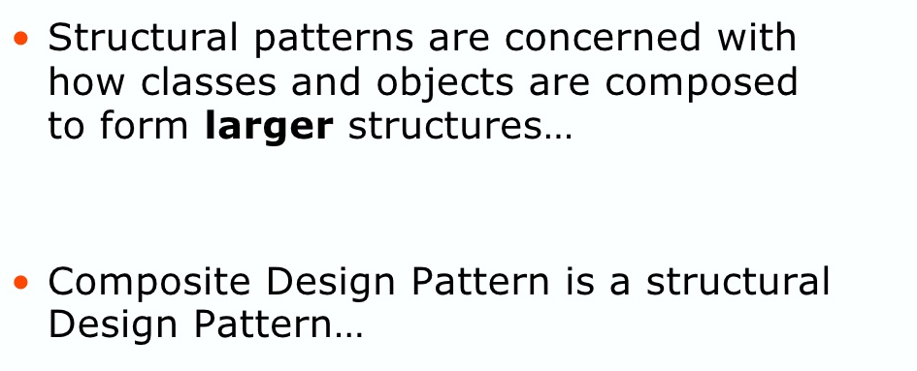
Structural Design Patterns

Slide 3
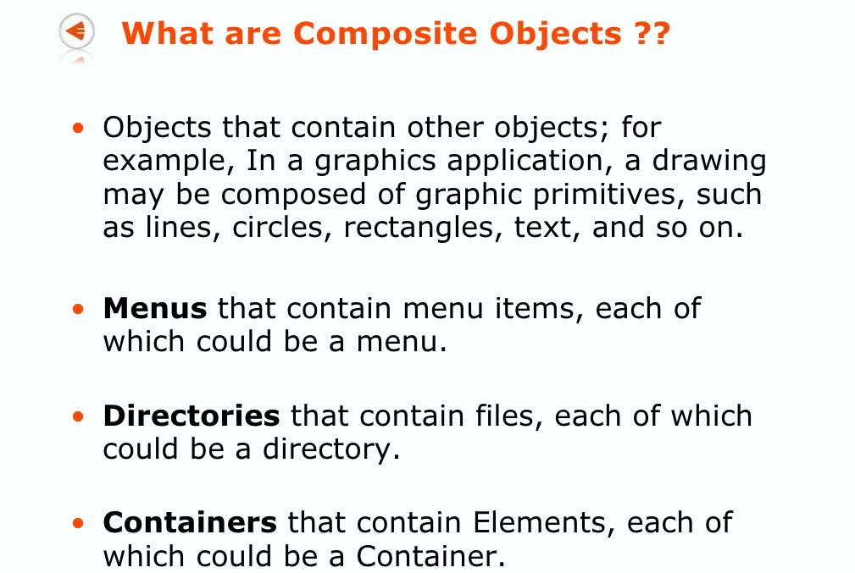
What are Composite Objects ?

Slide 4
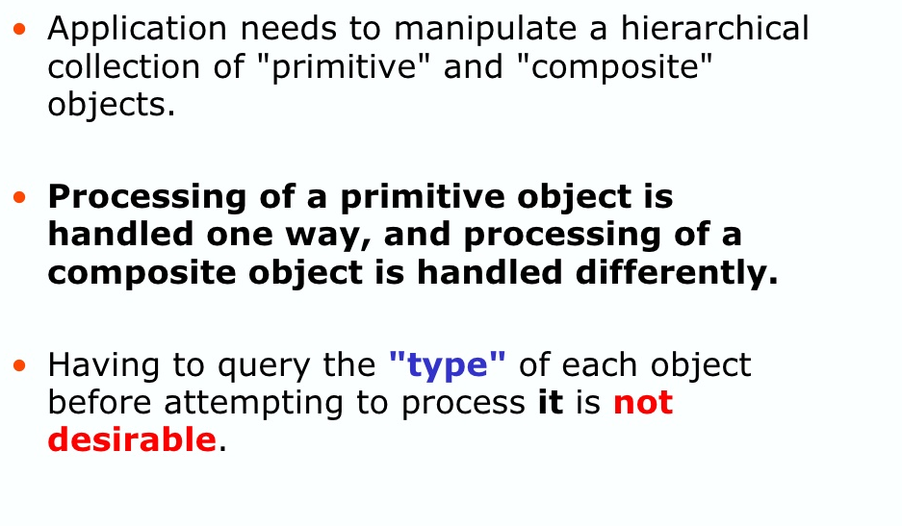
Problems handling primitives and composites

Slide 5
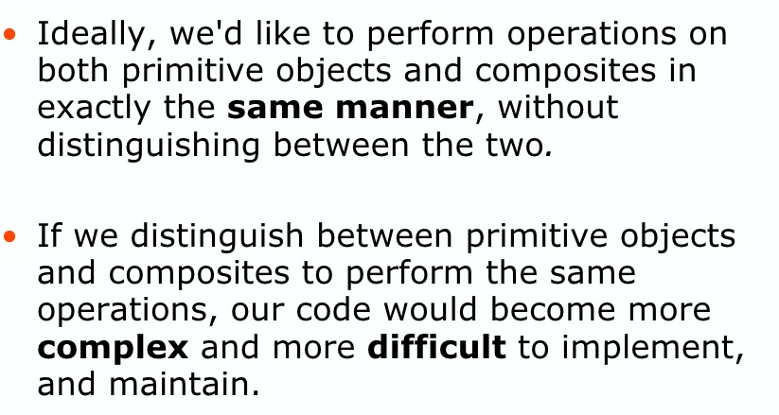
Why Composite Design Pattern ?
Notes:
Java developers need the composite design pattern because we often want to manipulate composite objects exactly the same way we manipulate primitive objects.

Slide 6
Composite Design Pattern
It is one of the structural design patterns.
Compose objects into tree structures to represent whole-part hierarchies.
Composite lets clients treat individual objects and compositions of objects uniformly.
Applied on problems having ‘has a’ relationship or hierarchy.
In this way, group of objects (composite) can be treated
the same way as individual objects (leaf).
Notes:
The composite pattern describes a group of objects that is treated the same way as a single instance of the same type of object. The intent of a composite is to "compose" objects into tree structures to represent part-whole hierarchies. Implementing the composite pattern lets clients treat individual objects and compositions uniformly.
Composite pattern is used where we need to treat a group of objects in similar way as a single object. Composite pattern composes objects in term of a tree structure to represent part as well as whole hierarchy.

Slide 7
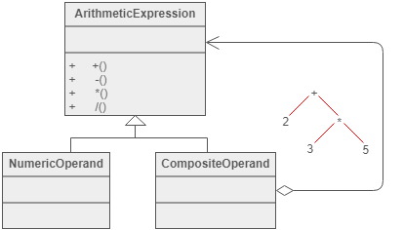
Example
The Composite composes objects into tree structures and lets clients treat individual objects and compositions uniformly.
Notes:
Although the example is abstract, arithmetic expressions are Composites. An arithmetic expression consists of an operand, an operator (+ - * /), and another operand. The operand can be a number, or another arithmetic expression. Thus, 2 + 3 and (2 + 3) + (4 * 6) are both valid expressions.

Slide 8
When to use composite?
Composite pattern should be applied only when the group of objects should behave as the single object.
The client doesn’t discriminate on group or individual objects.
When we want to create a tree like structure.

Slide 9
Basic Structure of Composite
Component
declares interface for objects in composition.
implements default behaviour for the interface common to all classes as appropriate.
declares an interface for accessing and managing its child components.
Leaf
represents leaf objects in the composition.
A leaf has no children.
defines behaviour for primitive objects in the composition.
Composite
defines behaviour for components having children.
stores child components.
implements child related operations in the component interface.
Client
manipulates objects in the composition through the component interface.

Slide 10
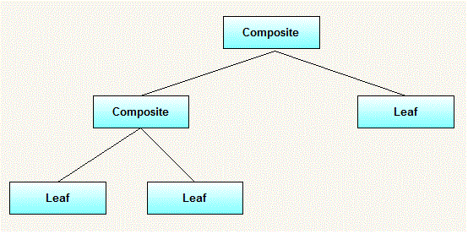
Basic Structure of Composite

Slide 11
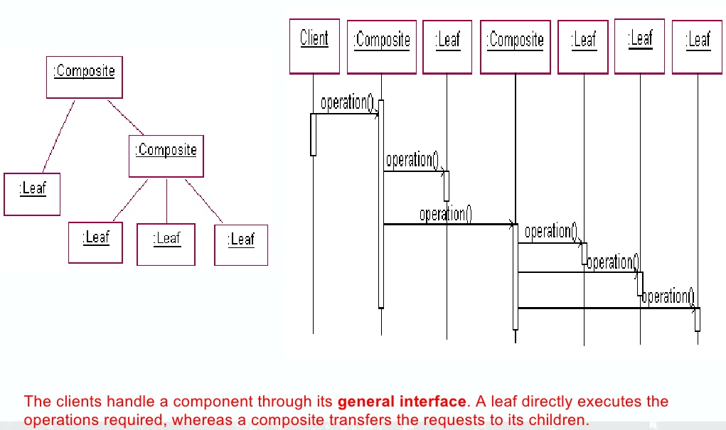

Slide 12
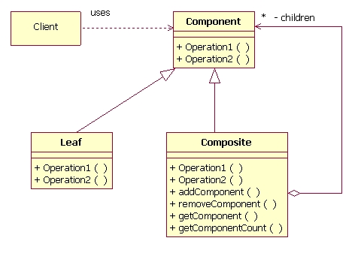
Basic Structure of Composite
Notes:
Client manipulates objects in the composition through component interface.
composite defines behaviour for components having children.

Slide 13
Example
Lets understand it with a real life example – Suppose we want to buy a computer. We can buy individual components or the computer as a whole. A computer consists of many components viz. Case, peripherals etc. The case in turn consists of other components (MotherBoard etc). We can buy composite components in the same way as individual ones.
Component (Interface)
Composite (Computer, Peripheral, Case etc.)
Leaf (HDD, RAM, mouse, keyboard etc.)

Slide 14
Component
Composite pattern base component defines the common methods for leaf and composites. We can create a class with a method draw(String fillColor) to draw the shape with given color.
Component.java
interface Component {
void showPrice();
int getPrice();
}

Slide 15
THANK YOU

